Slide 1
Volcano Hazard Monitoring in New Zealand
Cam Asher
Volcanology Technician
Feb 2021 for GVMID Workshop

Slide 2
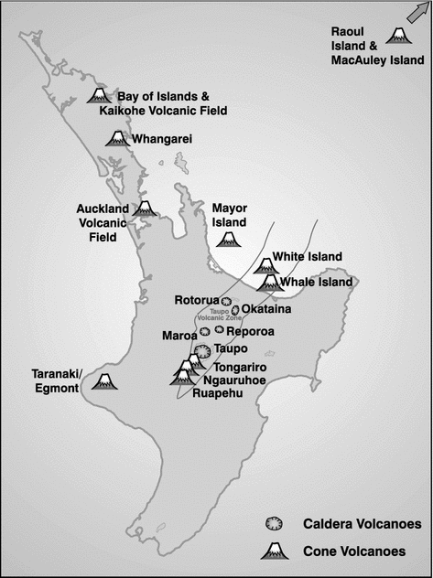
Current State
Geohazard monitoring, not volcano monitoring
Staff split time between monitoring and research
One data centre
ALL data is available freely to the public (www.geonet.org.nz)
Miller and Jolly (2014)

Slide 3
Current State – Active Volcanoes
Good: seismic, acoustic, webcam, geochemistry
Could be better: cGPS, feature monitoring (lakes and fumaroles), webcam
Weak: thermal, continuous gas
Cam Asher

Slide 4
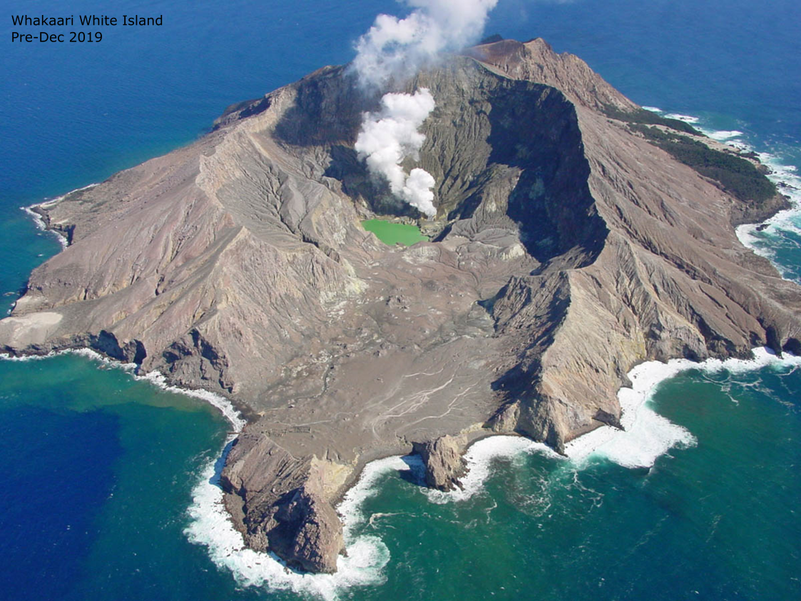
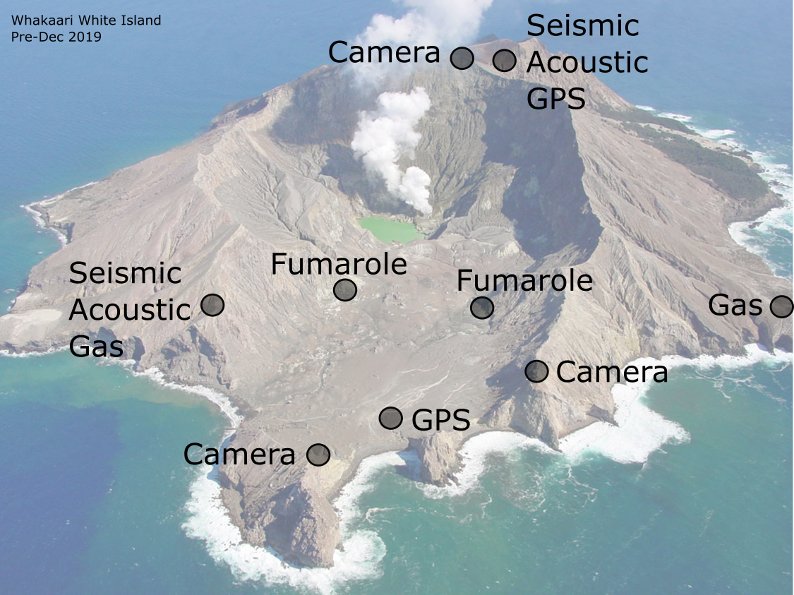
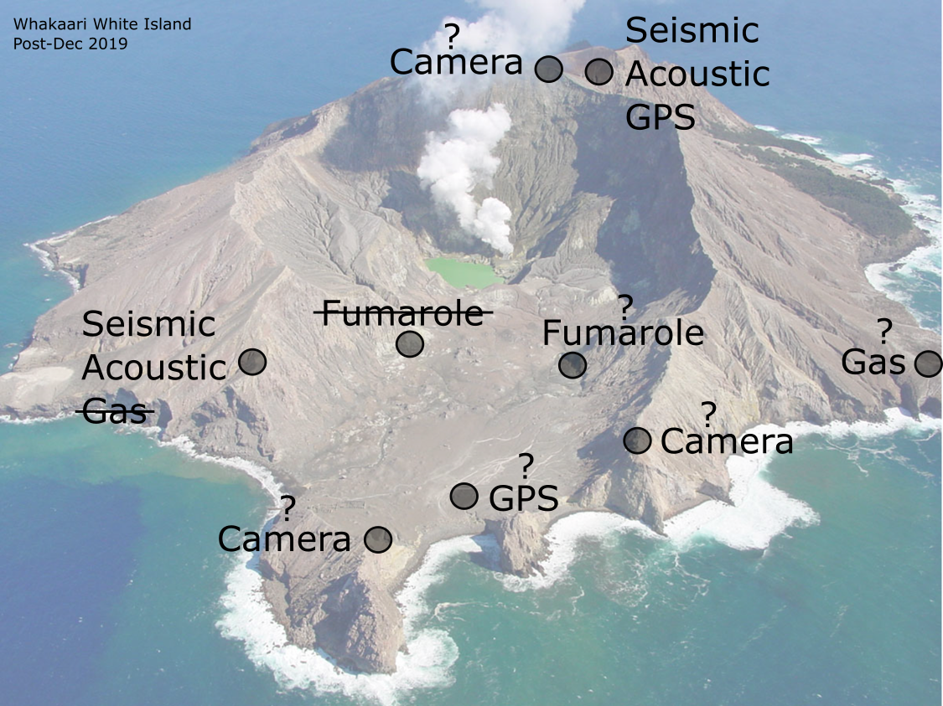
Greg Vaughan, 2001

Slide 5
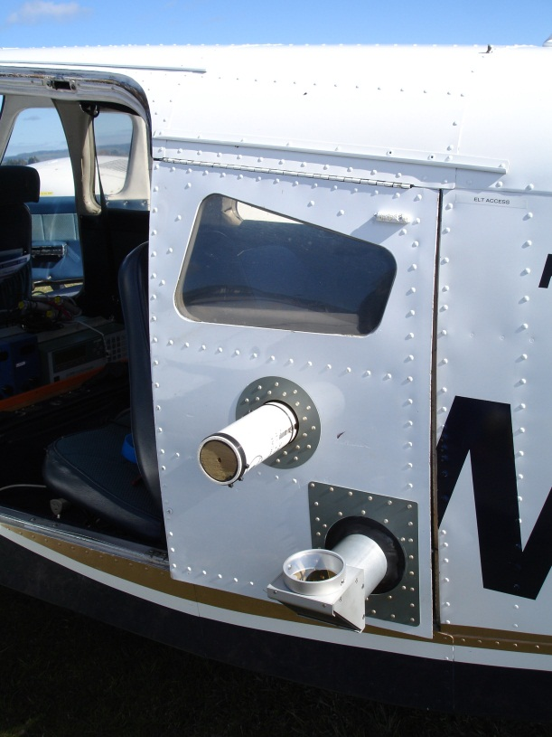
Remote Sensing
Airborne
Monthly or on demand
CO2, SO2, H2S
Reliant on weather
Terrestrial
DOAS + Flyspec

Slide 6
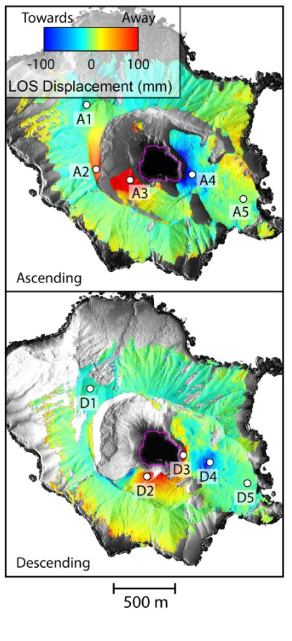
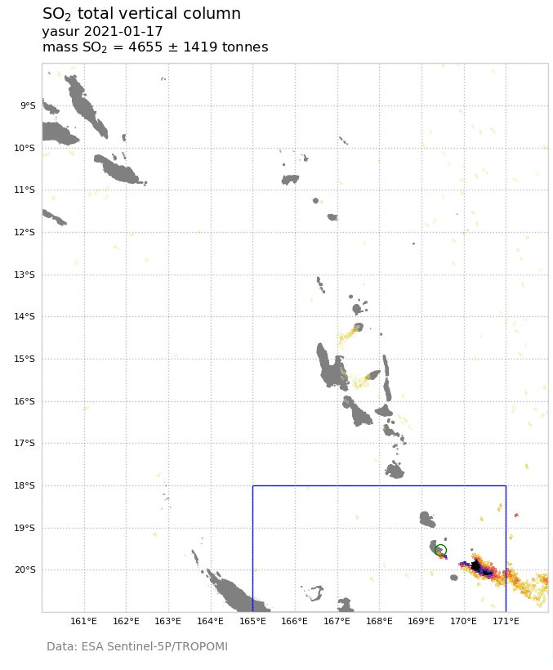
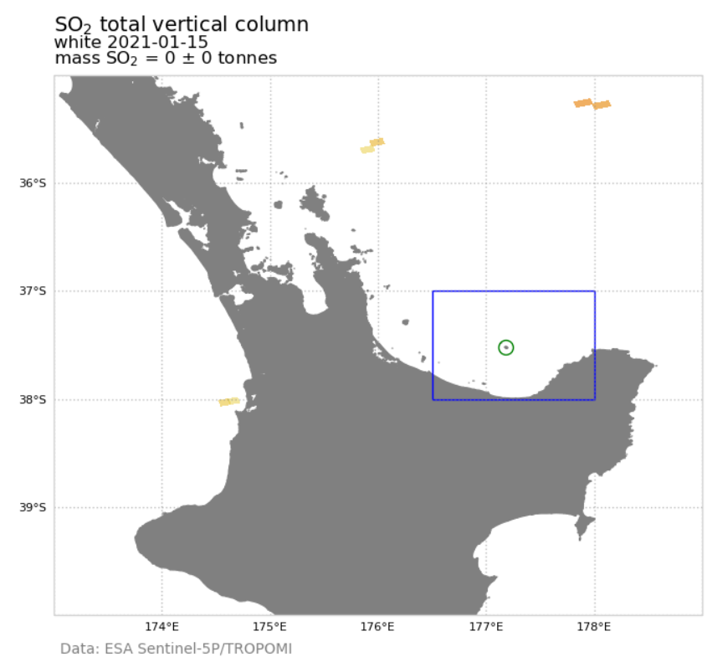
Remote Sensing
InSAR (TerraSAR-X)
Replaces manual/low resolution data
Steep crater walls
Base model issues
TropOMI SO2 (Sentinel5)
Need gas to be useful!
Hamling (2020)

Slide 7
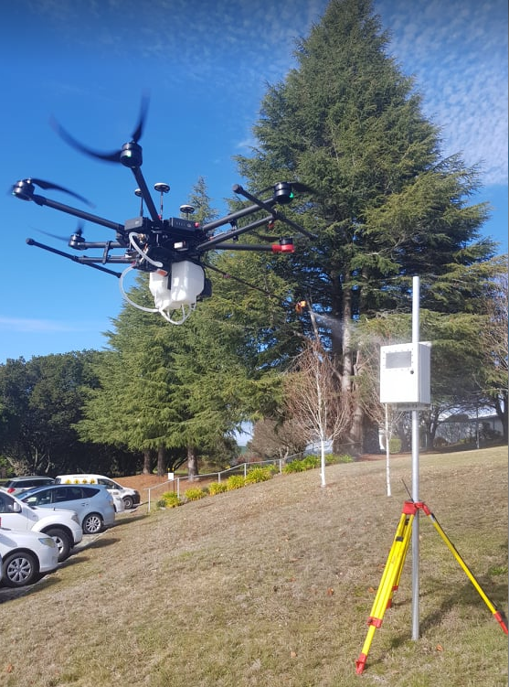
Where can we improve?
Access during volcanic activity is always an issue
Continue UAS Program
Improve airborne capabilities
Sentinel Hub

Slide 8
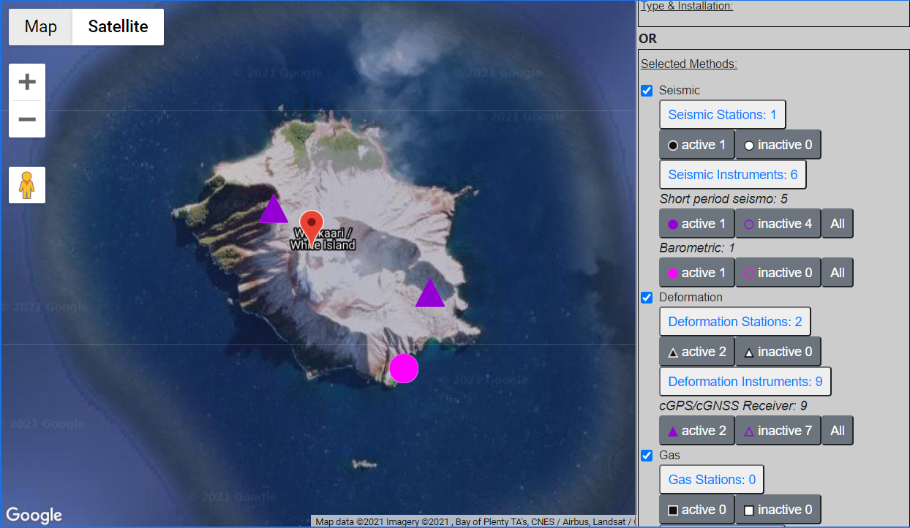
Current GVMID Map of White Island

